Slide 1
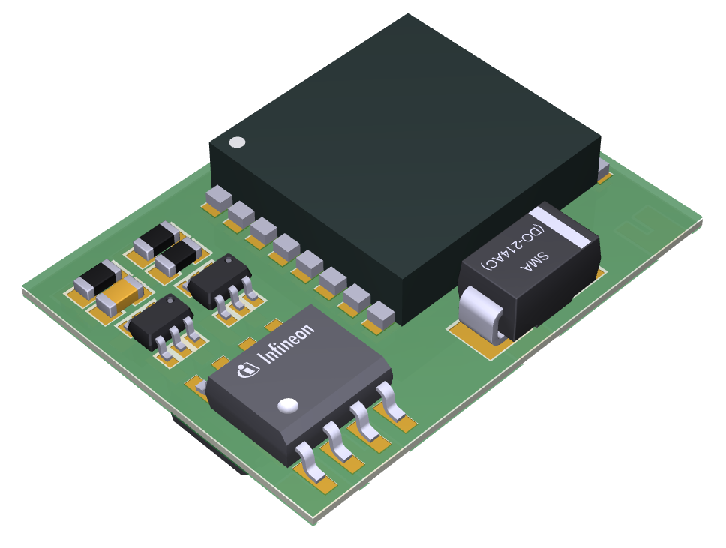
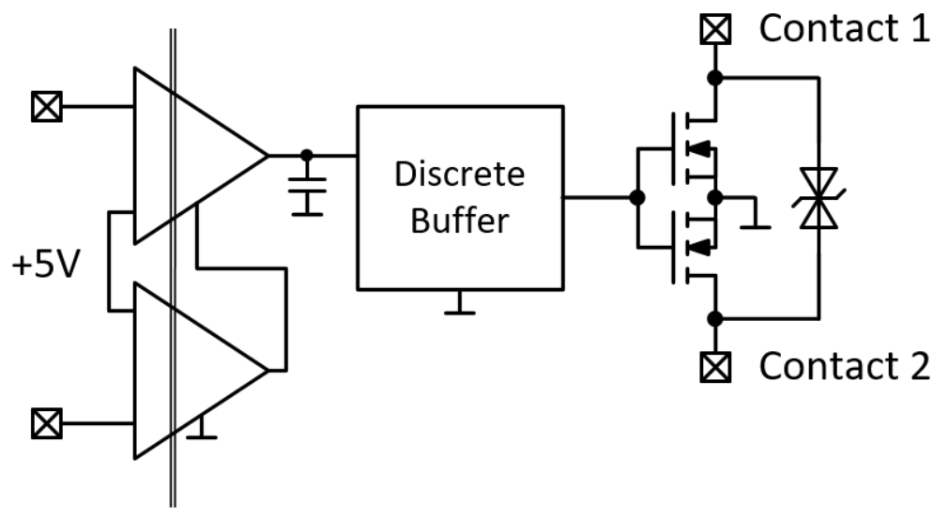
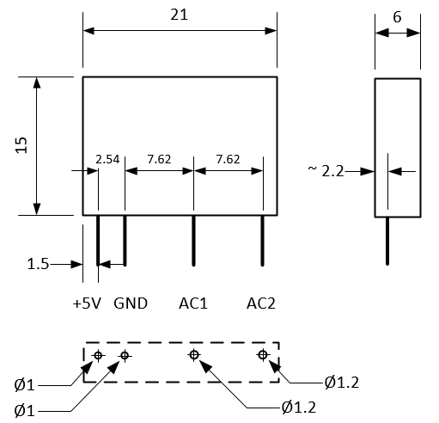
CoolMOS™ SSR – Demonstrator for in-circuit evaluation – Version 1
Input | +5 V / 5 .. 20 mA | diode-like input, external current limitation necessary
Output | 250 V_{AC} / 2 A | Resistive / capacitive load tested (X=15)
R_{DSon} | 44 mΩ / 80 mΩ | Total resistance
Isolation | 600 V_{RMS} basic | Contact 1 – Contact 2 Input - Output
Temperature | 0°C .. 75°C | Limited by Gate driver
Dimensions | 15 x 21 x 6 mm | h x w x d
Constructed space
Prototypes will be provided
as coated PCBs w/o
2nd level packaging (housing).
PCB footprint

